Slide 1
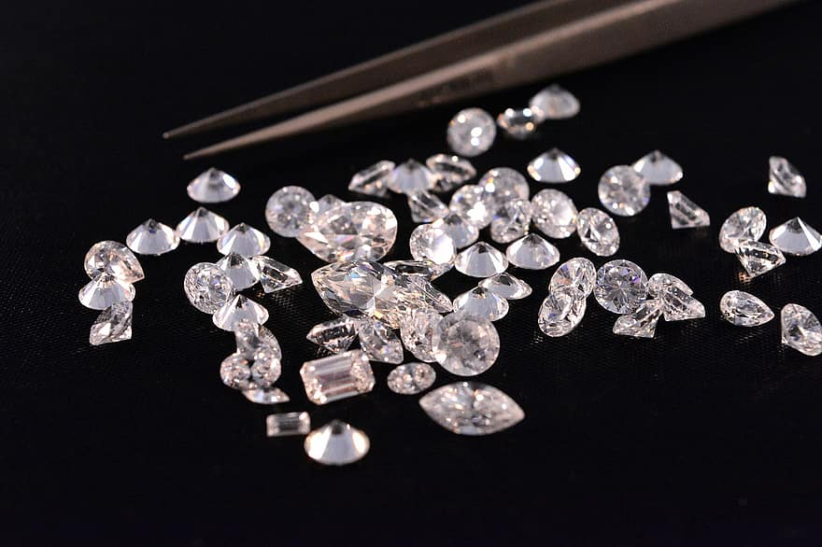
PREDICTIVE ANALYTICS
Solving Real Life Problems using Data Science

Slide 2




Connect with me on social media !
Hi,
Linkedin
Hi,
facebook
Am Mandieng Bot, am a Machine Learning Developer and Data Scientist. Whenever am not Building models or Working on Projects i enjoy Learning, Teaching and Talking about Data Science.
Twitter
github

Slide 3
Real life Applicability of Data Science
“Data scientists engage in various applications to analyze data and create technologies. These are eight common ones, with examples from different organizations and industries”
In particular, data science practices, methodologies, tools and technologies give organizations the capabilities they need to gain valuable information from ever-increasing amounts of highly variable data.

Slide 4
While many different types of organizations are implementing analytics applications driven by data science, those applications are mostly focused on areas that have proven their value over the past decade. By digging deeper into them, businesses can gain benefits that include competitive advantages over business rivals; better service to customers, citizens, users and patients; and the ability to respond more effectively to a rapidly changing business environment that demands continuous adaptation.

Slide 5
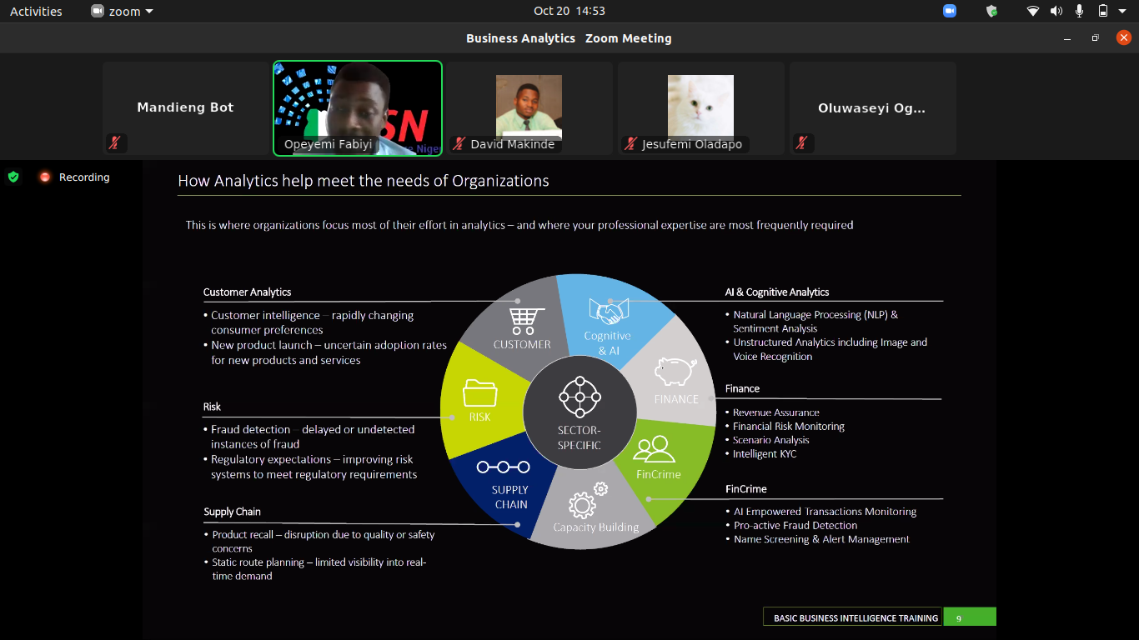
Data Science Applications and Business Use Cases

Slide 6
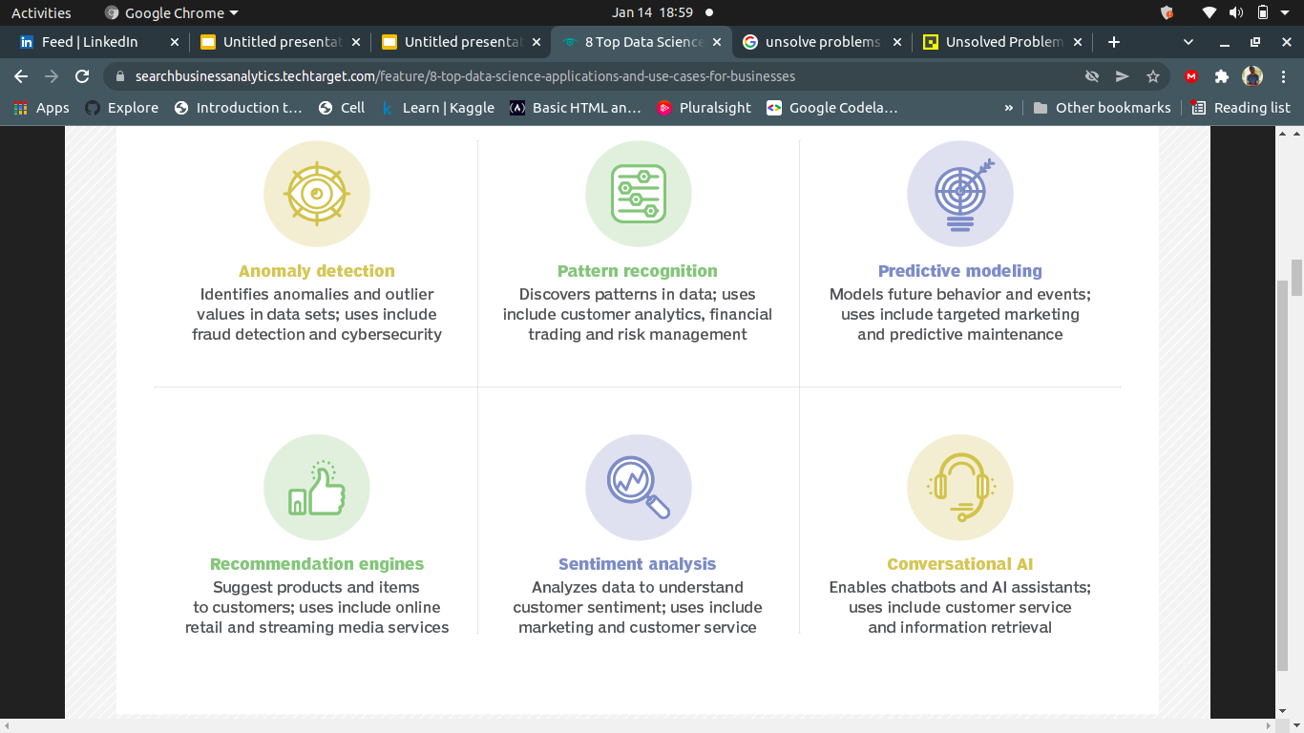
Use Cases for Businesses

Slide 7
The Diamond Problem Walkthrough

Slide 8
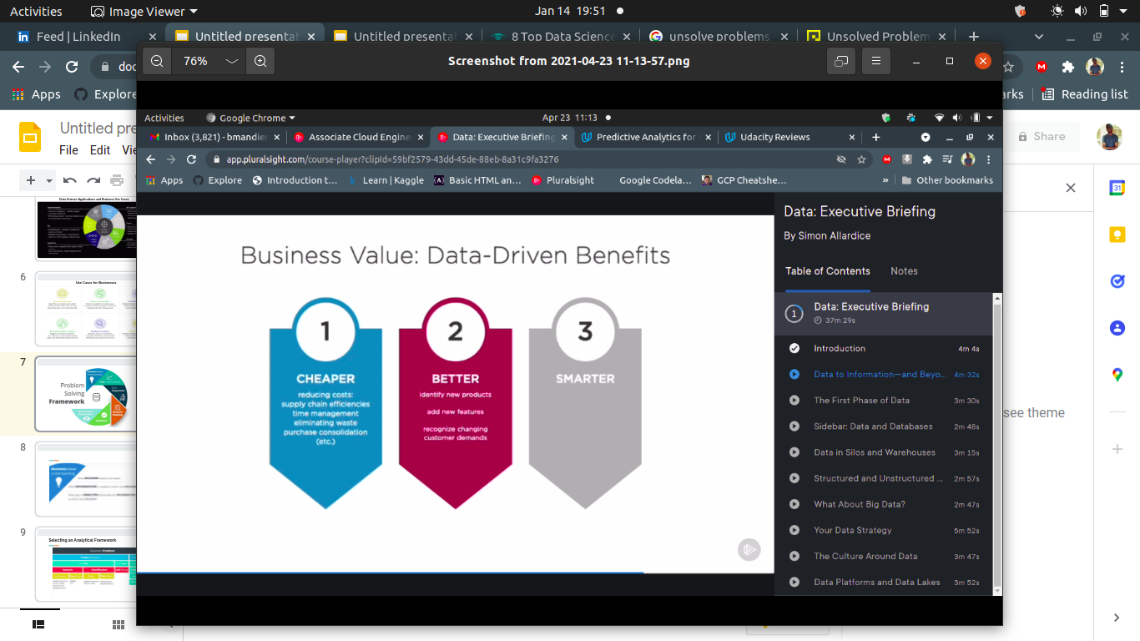

Slide 9
Our Business Problem
A & B Glams, a jewelry company wants to put in a bid to purchase a large set of diamonds, but is unsure on how much it should bid. As Data Scientists, we are tasked with using Predictive Analytics to make a recommendation on how much A & B Glams should bid for the diamonds
Project details
A diamond distributor Mr Smith, has recently decided to exit the market and has put up a set of 3,000 diamonds up for auction. Seeing this as a great opportunity to expand its inventory, A & B Glams has shown interest in making a bid. To decide how much to bid, we will use a large database of diamond prices to build a model to predict the price of a diamond based on its attributes. Then you will use the results of that model to make a recommendation for how much the company should bid.

Slide 10
Data Understanding
STEP 1: There are two data sets, diamonds.csv which contains the data used to build the regression model and new_diamonds.csv which contains the data for the diamonds the company will like to purchase. Both datasets contains carat, cut and clarity data for each diamond. Only diamonds.csv dataset has the prices(our target label). You will be predicting the prices for the new_diamonds.csv dataset.
Carat represents the weight of the diamond and is a numerical variable
Cut represents the quality of the cut of the diamond, and falls into 5 categories: fair,good,very good, ideal and premium.
Clarity represents the internal purity of the diamond and falls into 8 categories: l1,s12,s11,vs2,vs1,vvs2,vvs1 and 1f (in order from the least to the most pure)
Color represents the color of the diamond, and it is rated D through j, with D being the most colorless (and valuable and j being the most yellow.

Slide 11
Review the business problem
From the Data, we have one data set with 50,000 diamonds with data on cut,clarity,color,carat weight and retail price. For this batch we have the same information , minsu the price.
Ultimately, we want to recommend the bid price for the entire batch, which will be 70% of the sum of the predicted diamond prices.

Slide 12
DATA PREPARATION AND MODEL BUILDING
We will be building a Linear Regression model

Slide 13

Tools
Python libraries used;
Sklearn
Jupyter notebook
Pandas
Numpy
Matplotlib
Seaborn
Resources and full source code @ click link github

Slide 14
Objectives to guide our analysis
We will use this questions as objectives to guide our analysis,
Answer the following questions:
According to the model, if a diamond is 1 carat heavier than another with the
same cut, how much more should I expect to pay? Why?
If you were interested in a 1.5 carat diamond with a Very Good cut (represented by a 3 in the model) and a VS2 clarity rating (represented by a 5 in the model), how much would the model predict you should pay for it?

Slide 15
Understanding the Model’s Results
Answer the following questions:
According to the model, if a diamond is 1 carat heavier than another with the
same cut, how much more should I expect to pay? Why?
Ans= the price expected to pay $8,413 more, because that is the constant price and the difference between prices of two diamonds of the same cut but different carat is 8413, hence the carat is the strongest determinant of the price of the diamonds, as indicated by the high level of correlation between carat and prices.
If you were interested in a 1.5 carat diamond with a Very Good cut (represented by a 3 in the model) and a VS2 clarity rating (represented by a 5 in the model), how much would the model predict you should pay for it?
Ans= the model predicted $10,949 and $8,727 for two diamonds matching the desired specifications, so I would pay $9,838, which is the mean value for the two prices predicted by the model.

Slide 16
Making Business Recommendation
Answer the following questions:
What price do you recommend the jewelry company to bid? Please explain how
you arrived at that number.
Ans= I will recommend the jewelry company to bid $8,213,466 for the diamonds.
I arrived at this value by multiplying the total retail value(sum total of the predicted diamond prices) which totals to $11,733,523 by 70% since the company targets purchases the diamonds at just 70% of the retail value.

Slide 17
Conclusion
Data Science has a lot of applications in the wider world, most especially at a time when the whole world is digitized, and we have an abundance of data. Data science equips us with the tools and methods of deriving insights from the abundant data that is being generated everyday.
There is no denying the fact that Data Science is one of the fastest-growing fields along with its job opportunities.
The global machine learning market is expected to reach $20.83 Billion by the year 2024. That’s massive! According to Payscale, the average pay scale of a Data scientist in Nigeria is ₦1,375,767 , An early career Data Scientist with 1-4 years of experience earns an average total compensation (includes tips, bonus, and overtime pay) of ₦1,375,767 based on 22 salaries. A mid-career Data Scientist with 5-9 years of experience earns an average total compensation of ₦1,960,000 based on 9 salaries.

